Slide 1
OPERATING SYSTEMS (CS F372) Synchronization
Dr. Barsha Mitra
CSIS Dept., BITS Pilani, Hyderabad Campus

Slide 2
Background
Processes can execute concurrently
May be interrupted at any time, partially completing execution
Concurrent access to shared data may result in data inconsistency
Maintaining data consistency requires mechanisms to ensure the orderly execution of cooperating processes
Consider the Producer-Consumer problem

Slide 3
Producer - Consumer
while (true) { /* produce an item in next produced */
while (counter == BUFFER_SIZE) ;
/* do nothing */
buffer[in] = next_produced;
in = (in + 1) % BUFFER_SIZE;
counter++;
}
while (true) {
while (counter == 0)
; /* do nothing */
next_consumed = buffer[out];
out = (out + 1) % BUFFER_SIZE;
counter--;
/* consume the item in next consumed */
}

Slide 4
Race Condition
counter++ could be implemented as register1 = counter register1 = register1 + 1 counter = register1
counter-- could be implemented as register2 = counter register2 = register2 - 1 counter = register2
Consider this execution interleaving with counter = 5 initially:
S0 | producer execute register1 = counter | register1 = 5
S1 | producer execute register1 = register1 + 1 | register1 = 6
S2 | consumer execute register2 = counter | register2 = 5
S3 | consumer execute register2 = register2 – 1 | register2 = 4
S4 | producer execute counter = register1 | counter = 6
S5 | consumer execute counter = register2 | counter = 4

Slide 5
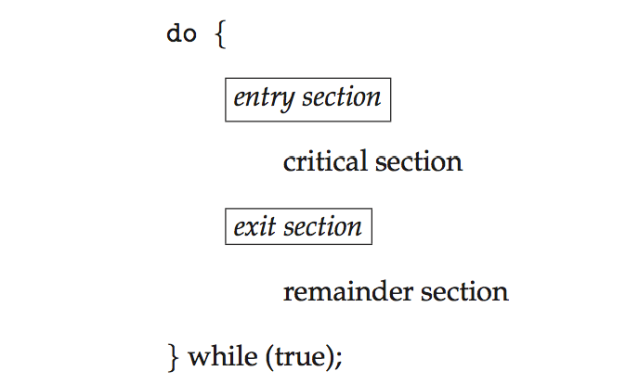
Critical Section Problem
Consider system of n processes {p₀ , p₁, … p_{n-1}}
Each process has critical section segment of code
Process may be changing common variables, updating table, writing file, etc.
When one process in critical section, no other may be in its critical section
Critical section problem is to design protocol to solve this
Each process must ask permission to enter critical section in entry section, may follow critical section with exit section, then remainder section

Slide 6
Requirements
1. Mutual Exclusion - If process P_{i} is executing in its critical section, then no other processes can be executing in their critical sections
2. Progress - If no process is executing in its critical section and some processes wish to enter their critical sections, then only those processes that are not executing in their remainder section can participate in deciding which will enter its critical section next, and this decision cannot be postponed indefinitely
3. Bounded Waiting - A bound must exist on the number of times that other processes are allowed to enter their critical sections after a process has made a request to enter its critical section and before that request is granted

Slide 7
Critical-Section Handling in OS
Two approaches depending on if kernel is preemptive or non-preemptive
Preemptive – allows preemption of process when running in kernel mode
Non-preemptive – runs until exits kernel mode, blocks, or voluntarily yields CPU
Essentially free of race conditions in kernel mode
Why then anyone would prefer preemptive kernel?????

Slide 8
Peterson’s Solution
Two process software based solution
Assume that the load and store machine-language instructions are atomic; that is, cannot be interrupted
The two processes share two variables:
int turn;
boolean flag[2];
The variable turn indicates whose turn it is to enter the critical section
The flag array is used to indicate if a process is ready to enter the critical section. flag[i] = true implies that process P_{i} is ready

Slide 9
Algorithm for Process P_{i}
do {
flag[i] = true;
turn = j;
while (flag[j] && turn = = j);
critical section
flag[i] = false;
remainder section
} while (true);
Provable that the 3 CS requirements are met:
1. Mutual exclusion is preserved
2. Progress requirement is satisfied
3. Bounded-waiting requirement is met

Slide 10
Check 3 Requirements
do {
flag[i] = true;
turn = j;
while (flag[j] && turn = = j);
critical section
flag[i] = false;
remainder section
} while (true);
P_{i}
do {
flag[j] = true;
turn = i;
while (flag[i] && turn = = i);
critical section
flag[j] = false;
remainder section
} while (true);
P_{j}

Slide 11
Synchronization Hardware
Many systems provide hardware support for implementing the critical section code
All solutions based on idea of locking
Protecting critical regions via locks
Uniprocessors – could disable interrupts
Currently running code would execute without preemption
Generally too inefficient on multiprocessor systems
Modern machines provide special atomic hardware instructions
Atomic = non-interruptible
Either test memory word and set value
Or swap contents of two memory words

Slide 12
Solution to Critical-section Problem Using Locks
do {
acquire lock
critical section
release lock
remainder section
} while (TRUE);

Slide 13
test_and_set Instruction
boolean test_and_set (boolean *target)
{
boolean rv = *target;
*target = true;
return rv;
}
Executed atomically
Returns the original value of passed parameter
Sets the new value of passed parameter to true

Slide 14
Solution using test_and_set Instruction
Shared Boolean variable lock, initialized to false, supports mutual exclusion and progress but not bounded waiting
do { while (test_and_set(&lock))
; /* do nothing */
/* critical section */
lock = false;
/* remainder section */
} while (true);

Slide 15
compare_and_swap Instruction
int compare_and_swap(int *value, int expected, int new_value)
{
int temp = *value;
if (*value == expected)
*value = new_value;
return temp;
}
Executed atomically
Returns the original value of passed parameter value
Sets the variable value the value of the passed parameter new_value but only if value == expected. That is, the swap takes place only under this condition.

Slide 16
Solution using compare_and_swap
Shared (global) integer lock initialized to 0;
Solution:
do { while (compare_and_swap(&lock, 0, 1) != 0)
; /* do nothing */
/* critical section */
lock = 0;
/* remainder section */
} while (true);

Slide 17
Bounded-waiting Mutual Exclusion with test_and_set
common data structures – boolean waiting[n], boolean lock, all initialized to false
do { waiting[i] = true; key = true; while (waiting[i] && key)
key = test_and_set(&lock);
waiting[i] = false;
/* critical section */
j = (i + 1) % n;
while ((j != i) && !waiting[j])
j = (j + 1) % n;
if (j == i)
lock = false;
else
waiting[j] = false;
/* remainder section */
} while (true);

Slide 18
Mutex Locks
Hardware solutions are complicated and generally inaccessible to application programmers
OS designers build software tools to solve critical section problem
Simplest is mutex lock
Protect a critical section by first acquire() a lock then release() the lock
mutex lock has a boolean variable available indicating if lock is available or not
Calls to acquire() and release() must be atomic
Usually implemented via hardware atomic instructions
But this solution requires busy waiting
This lock therefore called a spinlock

Slide 19
acquire() and release()
acquire() { while (!available)
; /* busy wait */
available = false;;
}
release() {
available = true;
}
do {
acquire lock
critical section
release lock
remainder section
} while (true);
Adv. of Spinlock:
no context switch is required when a process must wait on a lock
useful when locks are to be held for short times
Disadv. of Spinlock: busy waiting wastes CPU cycles

Slide 20
Semaphore
Provides more sophisticated ways (than mutex locks) for process to synchronize
Semaphore S – integer variable
Apart from initialization, can only be accessed via two indivisible (atomic) operations, wait() and signal(), Originally called P() and V()
Definition of the wait() operation
wait(S) {
while (S <= 0)
; // busy wait
S--;
}
Definition of the signal() operation
signal(S) {
S++;
}

Slide 21
Semaphore Usage
Counting semaphore – integer value can range over an unrestricted domain
Binary semaphore – integer value can range only between 0 and 1
Must guarantee that no two processes can execute the wait() and signal() on the same semaphore at the same time

Slide 22
Semaphore Implementation
With each semaphore there is an associated waiting queue
Each semaphore has:
value (of type integer)
a list of processes
Two operations:
block – place the process invoking the operation on the appropriate waiting queue
wakeup – remove one of processes in the waiting queue and place it in the ready queue
typedef struct{
int value;
struct process *list;
} semaphore;

Slide 23
Semaphore Implementation
wait(semaphore *S) {
S->value--;
if(S->value < 0){
add this process to S->list;
block();
}
}
signal(semaphore *S) {
S->value++;
if(S->value <= 0){ remove a process P from S->list;
wakeup(P);
}
}

Slide 24
Deadlock and Starvation
Deadlock – two or more processes are waiting indefinitely for an event that can be caused by only one of the waiting processes
Let S and Q be two semaphores initialized to 1
P₀ P₁
wait(S); wait(Q);
wait(Q); wait(S);
... ...
signal(S); signal(Q);
signal(Q); signal(S);
Starvation – indefinite blocking , A process may never be removed from the semaphore queue in which it is suspended

Slide 25
Classical Problems of Synchronization
Bounded-Buffer Problem
Readers and Writers Problem
Dining-Philosophers Problem

Slide 26
Bounded-Buffer Problem
Buffer of length n, each location can hold one item (int n)
Semaphore mutex initialized to the value 1
Semaphore full initialized to the value 0
Semaphore empty initialized to the value n

Slide 27
Bounded-Buffer Problem
Structure of the producer process
do {
... /* produce item in next_produced */
...
wait(empty);
wait(mutex);
... /* add next_produced to the buffer */
...
signal(mutex);
signal(full);
} while (true);
Structure of the consumer process
do {
wait(full);
wait(mutex);
... /*remove item from buffer to next_consumed*/
...
signal(mutex);
signal(empty);
... /*consume the item in next_consumed */
...
} while (true);

Slide 28
Readers-Writers Problem
A data set is shared among a number of concurrent processes
Readers – only read the data set; they do not perform any updates
Writers – can both read and write
Problem – allow multiple readers to read at the same time
Only one single writer can access the shared data at the same time
First readers-writers prob. → no reader is kept waiting unless a writer has already obtained the permission to use the shared obj., writers may starve

Slide 29
Readers-Writers Problem
Shared Data
Semaphore rw_mutex initialized to 1, common to both readers and writers, acts as a mutual exclusion semaphore for writers, used by first reader that enters CS or last reader that exits CS, not used by other readers
Integer read_count initialized to 0, keeps track of how many processes are reading the shared obj.
Semaphore mutex initialized to 1, ensures mutual exclusion when read_count is updated

Slide 30
Readers-Writers Problem
Structure of a writer process
do { wait(rw_mutex);
... /* writing is performed */
...
signal(rw_mutex);
} while (true);
Structure of a reader process
do { wait(mutex); read_count++; if (read_count == 1) wait(rw_mutex);
signal(mutex);
... /* reading is performed */
...
wait(mutex); read count--; if (read_count == 0) signal(rw_mutex);
signal(mutex);
} while (true);

Slide 31
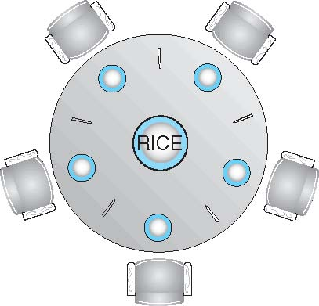
Dining-Philosophers Problem
Philosophers spend their lives alternating b/w thinking and eating
Don’t interact with their neighbors, occasionally try to pick up 2 chopsticks (one at a time) to eat from bowl
Can pickup only one chopstick at a time
Need both to eat, then release both when done
In the case of 5 philosophers
Shared data
Bowl of rice (data set)
Semaphore chopstick [5] initialized to 1

Slide 32
Dining-Philosophers Problem Algorithm
Structure of Philosopher i:
do {
wait (chopstick[i] );
wait (chopstick[ (i + 1) % 5] );
// eat
signal (chopstick[i] );
signal (chopstick[ (i + 1) % 5] );
// think
} while (TRUE);
What is the problem with this algorithm?

Slide 33
Dining-Philosophers Problem Algorithm
Deadlock handling
Allow at most 4 philosophers to be sitting simultaneously at the table.
Allow a philosopher to pick up the chopsticks only if both are available.
Use an asymmetric solution -- an odd-numbered philosopher picks up first the left chopstick and then the right chopstick. Even-numbered philosopher picks up first the right chopstick and then the left chopstick.

Slide 34
Problems with Semaphores
Incorrect use of semaphore operations:
signal (mutex) …. wait (mutex)
wait (mutex) … wait (mutex)
Omitting of wait (mutex) or signal (mutex) (or both)
Deadlock and starvation are possible.

Slide 35
Thank You

